Slide 1
Report for Community Council 22nd March – 16th April
By Fraser Thomson

Slide 2
Number
Total number of contacts with young people: 126
Total number of sessions delivered: 40
Total number of learning hours:132

Slide 3
What activities have been delivered
Virtual Youth Café
Online Quiz with Cromarty Primary School
Scavenger hunt with Cromarty Primary School.
1-1’s
Delivering online training
Hosted a meeting about the Kickstart programme for local businesses
Virtual Bakewell
Meet the Youth Work Team

Slide 4
Training that staff and young people have taken part in
Supporting Young people’s behaviour: Information for parents/ carers
Introduction to Risk Assessment
Young Carers Seen, Heard and Supported
Think You Know Neglect
Building the Ambition
Food Hygiene Level 1 & Level 2
How we eat
Smart Start
Digital Skills Level 2

Slide 5
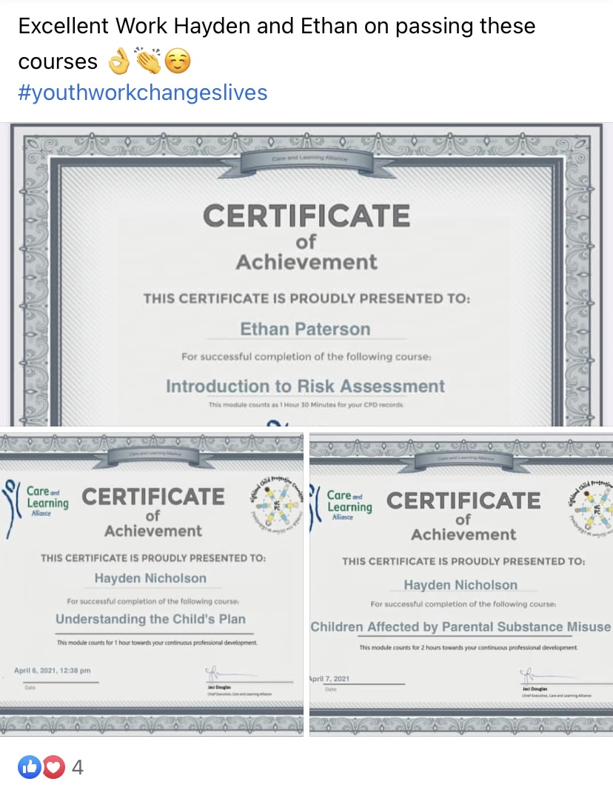
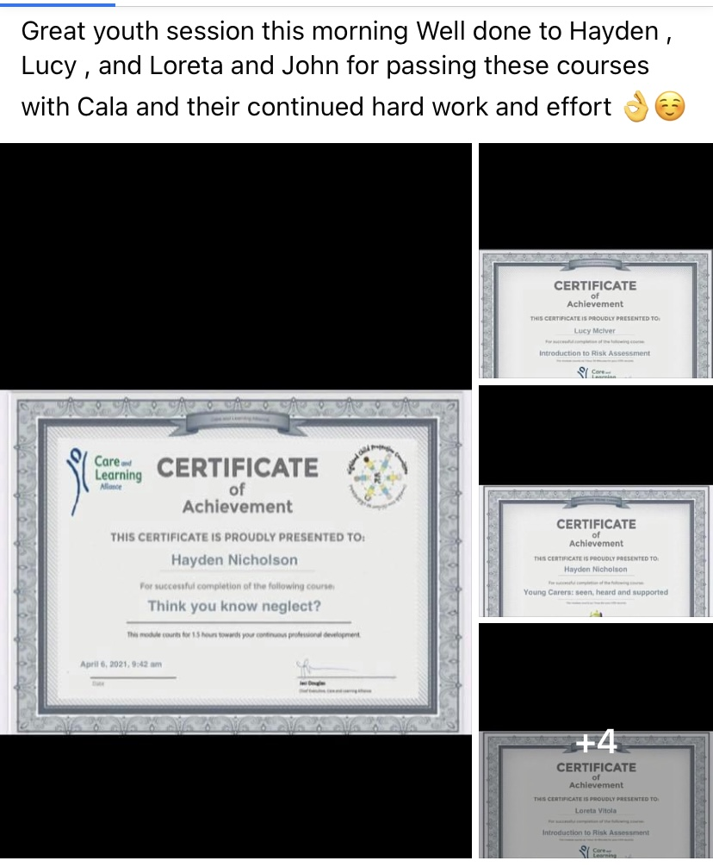

Slide 6
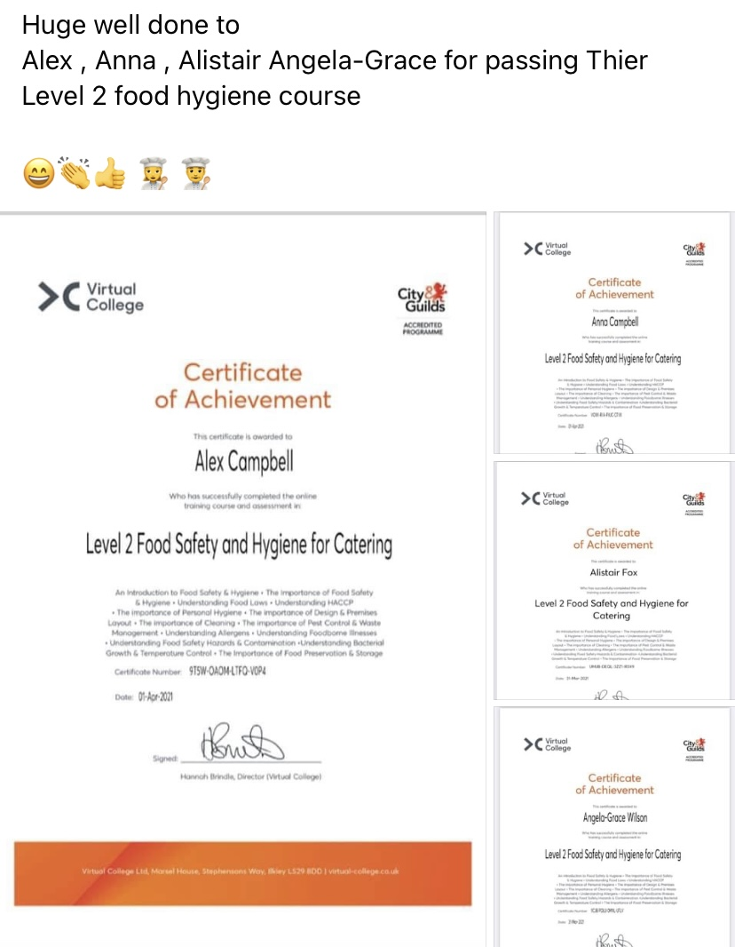

Slide 7
Easter Programme
This year we had a fun filled easter programme planned but due to the weather we had to go with plan B
Monday – meet the youth work team – this was done with a Quiz & Scavenger hunt – the young people that turned up enjoyed themselves
Tuesday – was meant to be outdoor Youth Café & Mountain biking
This was changed to an online Bakewell session
Wednesday this was a virtual check in with young people, to check in and also tell them that we are on holiday for a week and if they needed us to get in touch before the Friday.

Slide 8
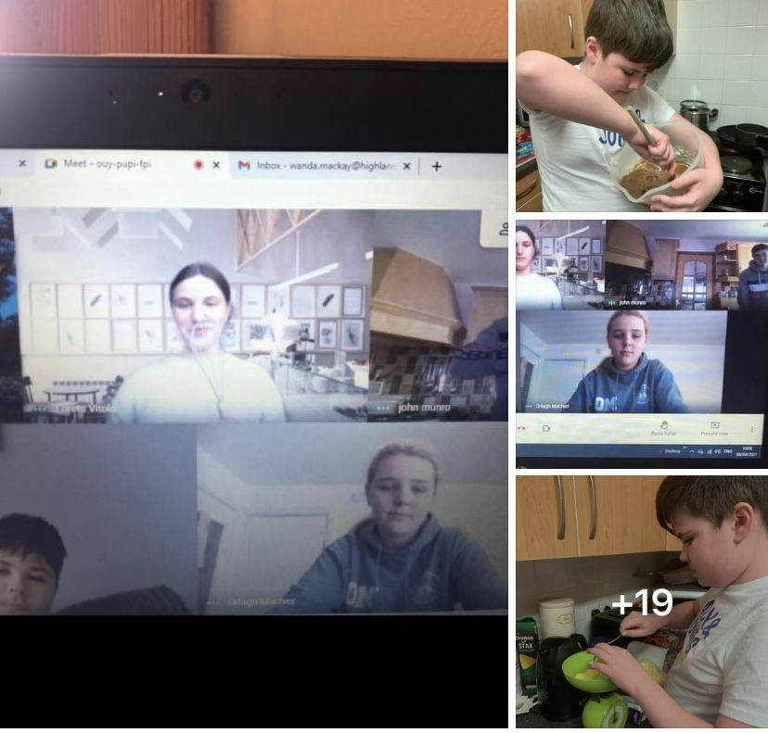

Slide 9
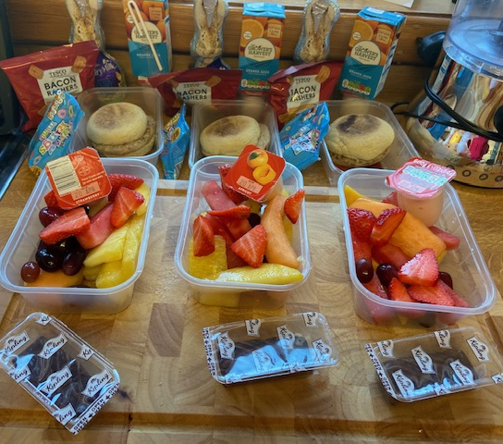
Every child that was booked onto this activities during the easter programme was given a packed lunch – Wanda prepared these in her house and then I delivered them to the young people doorstep.
The funding for holiday hunger came from MFR Cash for kids & Tesco Fare share
Baking Bag went out also for the young people who were going to attend the bakewell session
All of the young people were delighted their packed lunch bags

Slide 10
On Thursday 2nd April there was a meeting hosted with Laura Macmillan from the DWP to talk to local businesses about the Kick Start Programme
5 local businesses turned up
Laura presented the information about Kick Start and then allowed for people to ask her question
I was sent the PowerPoint to send out to local businesses that attended the meeting
Myself and Wanda continue to promote this scheme to young people and to local business if and when we see them

Slide 11
Virtual Youth Café
When – 3 times per week
What happens?
Each week there is a quiz and scavenger hunt
Training sessions / Emotional check-in’s
Breakfast Club
Each session young people are asked what they would like to do in the next session.
All of the young people really look forward to our next session and really enjoy taking part in everything that we do.

Slide 12
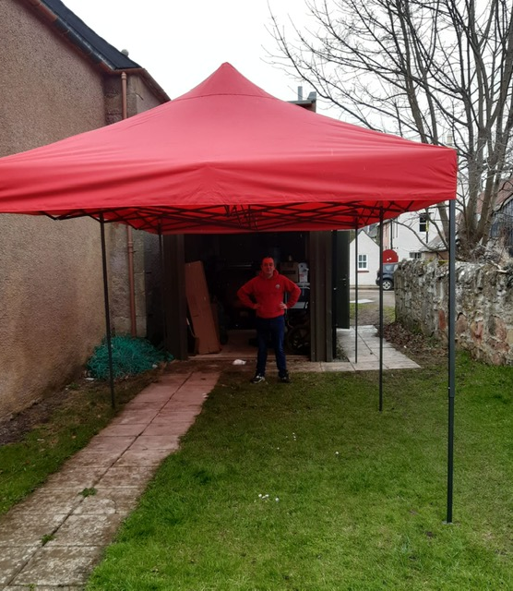
Cromarty Youth Café has an Outdoor Home!
Following funding from the Scottish Rural Action Fund, the Youth Café now has an outdoor home. Its first outing was meant to be for the Easter Programme, The gazebo cannot be missed, with its bright appearance, and will provide essential cover and protection from the often unpredictable Cromarty weather.

Slide 13
Equality Steering Group
Every Wednesday morning 3 young people from Cromarty meet
This is the steering group for the Equalities and Diversity Group
They have created a survey for the whole school
They have attended a meeting about the PSE review in Highland
The group have been working on a presentation for the Elected members – this is happening on Wednesday 28th April

Slide 14
MFR Emergency Grant
I worked with Wanda to do an application for MFR Emergency Grant to give families in need a little bit of support
This application was successful
22 young people benefited for this
The families were given Tesco vouchers & Electric vouchers
Amount of Money Granted - £2200

Slide 15
Young Scot Awards
I am getting in touch to say thank you for nominating Constantine, Allan, Tilly & Freya for a Sunday Mail Young Scot Award 2021. This year, our judges found it incredibly difficult to select the finalists. And, after much deliberation, these young people were not chosen as a finalist’s. I know this will be disappointing, however, being nominated for the Sunday Mail Young Scot Awards is an outstanding achievement that should be celebrated. We’ll soon be sending a certificate of recognition in the post.

Slide 16
1-1s
A lot of the 1-1s that happen are with young who don’t want to be part of a group setting, they feel more comfortable with a 1-1.
Through out these 1-1’s a number of training courses have been delivered
Sometimes young people just want to talk to someone and say how they are feeling to someone out with their family especially when they were at home all the time
Sometimes the 1-1’s are supporting with school work
A number of young people have told us about being anxious about going back to school and the pressures of going with back the up and coming assessments
Some of the things we are told at 1-1s would not be told to us in a group setting.

Slide 17
Quiz & Scavenger Hunt with Cromarty Primary School
These session have been really popular with the pupils in Cromarty Primary School.
At the last quiz Julie Dinwoodie (Head Teacher) Thanked myself and John for the hard work we have put in to enable the young people to have a quiz each week.
Every child in the primary school was given a chocolate easter egg from the Youth Café to say thank you to them for turning up each week.
Myself and John really enjoyed creating and taking part in the quiz.
Each week we both learnt something new.

Slide 18
Planning for next term
I have continued to plan the summer programme – I am waiting for a number of providers to come back to me with a definite answer, as they are not able to commit for a number of reasons. A couple providers need to ensure they have the staff to deliver activities, also some providers need to come and do a site visit to do a risk assessment.
I have been in contact with the primary school to discuss going forward and what I can do to support them during the spring term.

Slide 19
Meeting’s
Myself and Wanda attended a meeting with Maureen Cusick – Tenants Participation Officer with The Highland Council to discuss the possibility to take part in the Junior Warden Scheme –
Maureen explained about the scheme - The Junior Warden Scheme aims to provide an alternative and creative way to engage with young people and community groups, promote positive behaviour and encourage active involvement in the local community. The scheme aims to support young people to make a difference where they live and remove barriers to participation
We have arranged a meeting for the 4th May to discuss in more detail and have a look around the town.
Can give more information about this if needed.

Slide 20
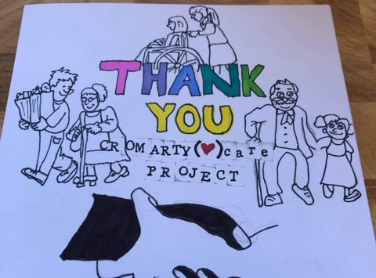
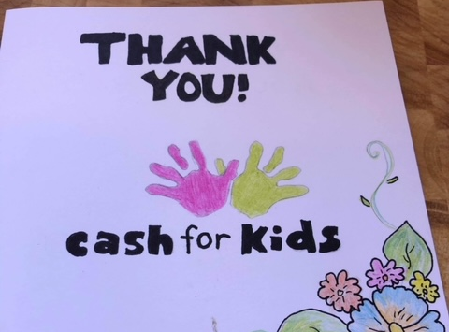
Thank you Cards that young people created for some of the funders.
Amount - £5000 for a
recovery Summer Programme
Amount - £1700 for Holiday Hunger & Cookwell

Slide 21
Thanks You’s for Families for the support we have given them.
Dear Fraser, Wanda, and all the ones that have been helping us, I am writing to thank this team of kind people who has been kindly supporting me after having a dark episode of my life and my family for over a long period of time during this pandemic. The activities of youth cafe really make a difference in the kids life in Cromarty. Also Fraser is been so helpful and caring towards our family. He is always there solving paper work and inviting us to activities. I have expressed our appreciation and really wish we can help the community back. With Warmest regards
Thank u so much for applying for that vouchers, those where a massive help and helped us get back up on our feet especially with electric as with the kids being at home and charging school chrome books and such like our electric has went through the roof money wise. Thank you so much for you continuing support for the kids through the youth cafe

Slide 22
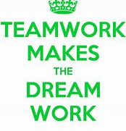
Our Staff
Cromarty Youth Café has a small team of 2 people, myself and John.
If I didn’t have John to support me, then Youth Café wouldn’t be able to run.
John has so much enthusiasm and he cares so much and loves his job.
Every week John works hard and nothing fazes him
John continues to learn each week, as do i.
Myself and John could not do any of the work we do with out the support of Wanda

